Slide 1

INTEGRATION & API DELIVERY
INTG-134 As an API Engineer, I want to know how Jenkins run with Groovy Script
Prepared by: Jeffrey M W Cheng (43339225)
Date: 2018.03.27

Slide 2


CONTENTS
JENKINS OVERVIEW
EASY INSTALLATION
PIPELINE
declarative pipeline
scripted pipeline
TOOLS & PLUGINS
credentials
git
jdk
maven
SHARED LIBRARY
global shared library
folder-level shared library
LESSONS TO SHARE
RESTRICTED

Slide 3
JENKINS OVERVIEW

Slide 4
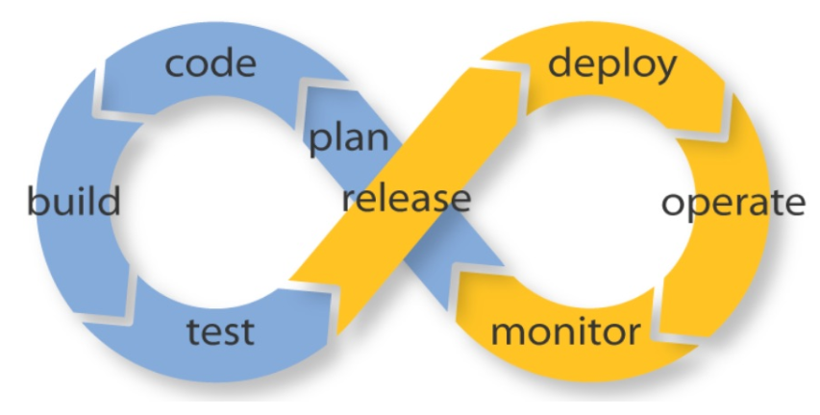
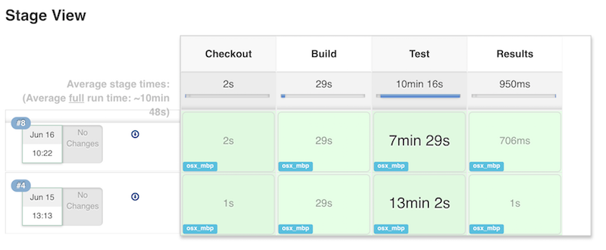
OVERVIEW
Jenkins is a self-contained, open source automation server with CI/CD functionalities. Jenkins can be used to automate all sorts of tasks related to building, testing, and delivering or deploying software
written in Java
runs in a servlet containers such as Apache Tomcat
supports version control tools, likes Git, GitHub, Subversion etc.
can execute Apache Ant, Apache Maven based projects as well as arbitrary shell scripts and Windows batch commands
RESTRICTED

Slide 5
EASY INSTALLATION

Slide 6
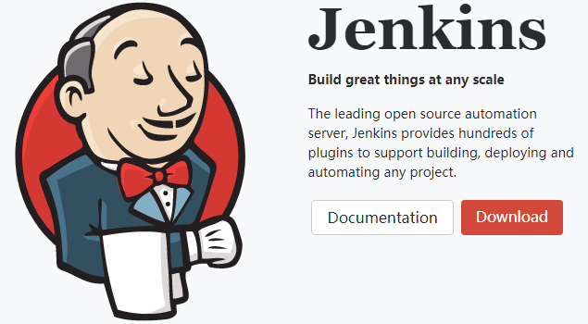
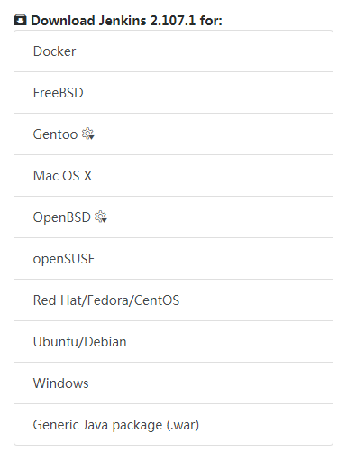
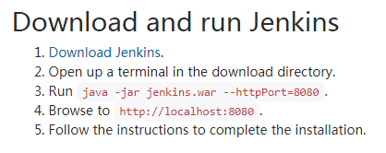
EASY INSTALLATION
RESTRICTED

Slide 7
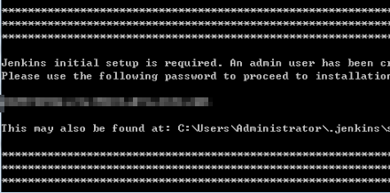
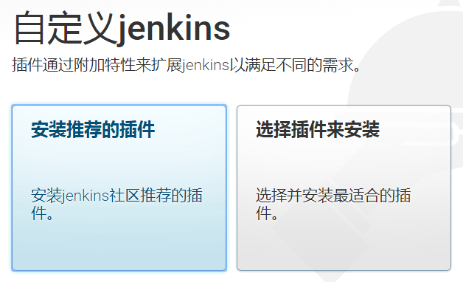

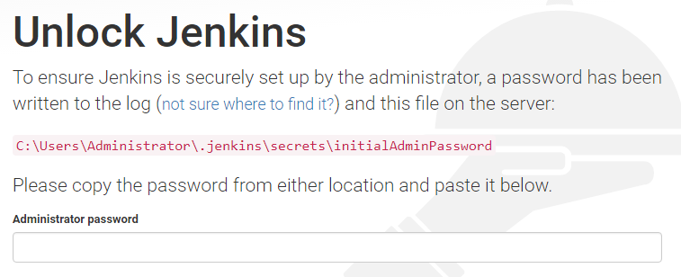
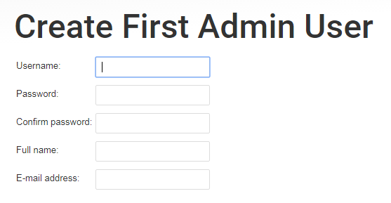
EASY INSTALLATION
RESTRICTED

Slide 8
PIPELINE

Slide 9
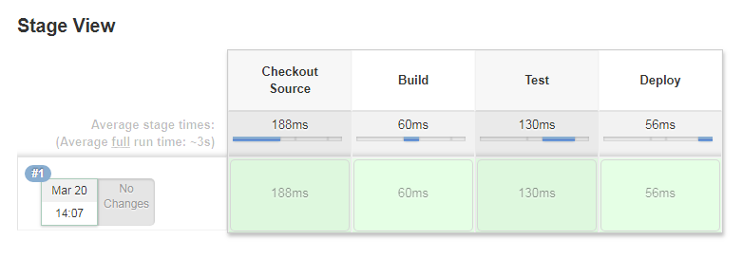
PIPELINE
What is a Jenkins Pipeline
Jenkins Pipeline is a suite of plugins which supports implementing and integrating continuous delivery pipelines into Jenkins
Define a Pipeline
2 Ways to define a pipeline
Scripted Pipeline
Declarative Pipeline
Recommended Way to Build Pipeline
Jenkinsfile
Extending Jenkinsfile with Shared Libraries
Global Shared Libraries
Folder Level Shared Libraries
PIPELINE SCRIPT
node {
stage('Source Checkout') {
git branch: 'master',
credentialsId: '52dfa145-d4a0-4240-bae9-8f786e323bbe',
url: 'ssh://{user}@{hostname}:{port}/{path}/{project}.git'
}
stage('Build') {
echo 'In Build Stage'
}
stage('Test') {
echo 'In Test Stage'
}
stage('Deploy') {
echo 'In Deploy Stage'
}
}
DECLARATIVE PIPELINE
pipeline {
agent any
stages {
stage('Source Checkout') {
steps {
}
}
stage('Build') {
steps {
}
}
...
...
}
}
RESTRICTED

Slide 10
PIPELINE
Scripted Pipeline
pipeline works inside a 'node' block does two things:
Schedules the steps contained within the block to run by adding an item to the Jenkins queue. The steps will run whenever executor free
Creates a workspace where work can be done on files checked out from source control
PIPELINE SCRIPT EXAMPLE
node {
stage('Source Checkout') {
git branch: 'master',
credentialsId: '52dfa145-d4a0-4240-bae9-8f786e323bbe',
url: 'ssh://user@www.hostname.com:port/path/project.git'
}
stage('Build') {
echo 'In Build Stage'
withMaven (maven: 'M3_5_2') {
// sh 'mvn clean package' for LINUX
bat 'mvn package'
}
}
stage('Test') {
echo 'In Test Stage'
withMaven(maven: 'M3_5_2') {
bat 'mvn test'
}
}
stage('Deploy') {
echo 'In Deploy Stage'
bat 'copy "target\\home-0.1.0.BETA.war" "C:\\Users\\Administrator\\Desktop"'
}
}
RESTRICTED

Slide 11
PIPELINE
DECLARATIVE PIPELINE EXAMPLE
pipeline {
agent any
stages {
stage('Source Checkout') {
steps {
git branch: 'master',
credentialsId: '52dfa145-d4a0-4240-bae9-8f786e323bbe',
url: 'ssh://user@www.hostname.com:port/path/project.git'
}
}
stage('Build') {
steps {
echo 'In Build Stage'
withMaven (maven: 'M3_5_2') {
// sh 'mvn clean package' for LINUX
bat 'mvn package'
}
}
}
stage('Test') {
steps{
echo 'In Test Stage'
withMaven(maven: 'M3_5_2') {
bat 'mvn test'
}
}
}
stage('Deploy') {
steps{
echo 'In Deploy Stage'
bat 'copy "target\\home-0.1.0.BETA.war" "C:\\Users\\Administrator\\Desktop"'
}
}
}
}
Declarative Pipeline
Declarative Pipeline is a more recent feature of Jenkins Pipeline which:
provides richer syntactical features over Scripted Pipeline syntax, and
is designed to make writing and reading Pipeline code easier
the pipeline block defines all the work done throughout your entire Pipeline.
RESTRICTED

Slide 12
PIPELINE SYNTAX - DECLARATIVE
DECLARATIVE vs SCRIPTED Pipeline
When Jenkins Pipeline was first created, Groovy was selected as the foundation and shipped with an embedded Groovy engine to provide advanced scripting capabilities;
Pipeline empowered by Groovy is now referred to as the "Scripted Pipeline" DSL;
The Groovy learning-curve isn’t typically desirable for all members of a given team;
Declarative Pipeline was created to offer a simpler and more opinionated syntax for authoring Jenkins Pipeline;
both able to use steps built into Pipeline or provided by plugins. Both are able to utilize Shared Libraries;
Declarative limits what is available to the user with a more strict and pre-defined structure, making it an ideal choice for simpler continuous delivery pipelines;
Scripted provides very few limits, insofar that the only limits on structure and syntax tend to be defined by Groovy itself, rather than any Pipeline-specific systems, making it an ideal choice for power-users and those with more complex requirements.
RESTRICTED

Slide 13
PIPELINE
DECLARATIVE PIPELINE EXAMPLE
pipeline {
agent any
stages {
stage('Source Checkout') {
steps {
git branch: 'master',
credentialsId: '52dfa145-d4a0-4240-bae9-8f786e323bbe',
url: 'ssh://user@www.hostname.com:port/path/project.git'
}
}
stage('Build') {
steps {
echo 'In Build Stage'
withMaven (maven: 'M3_5_2') {
// sh 'mvn clean package' for LINUX
bat 'mvn package'
}
}
}
stage('Test') {
steps{
echo 'In Test Stage'
withMaven(maven: 'M3_5_2') {
bat 'mvn test'
}
}
}
stage('Deploy') {
steps{
echo 'In Deploy Stage'
bat 'copy "target\\home-0.1.0.BETA.war" "C:\\Users\\Administrator\\Desktop"'
}
}
}
}
PIPELINE SCRIPT EXAMPLE
node {
stage('Source Checkout') {
git branch: 'master',
credentialsId: '52dfa145-d4a0-4240-bae9-8f786e323bbe',
url: 'ssh://user@www.hostname.com:port/path/project.git'
}
stage('Build') {
echo 'In Build Stage'
withMaven (maven: 'M3_5_2') {
// sh 'mvn clean package' for LINUX
bat 'mvn package'
}
}
stage('Test') {
echo 'In Test Stage'
withMaven(maven: 'M3_5_2') {
bat 'mvn test'
}
}
stage('Deploy') {
echo 'In Deploy Stage'
bat 'copy "target\\home-0.1.0.BETA.war" "C:\\Users\\Administrator\\Desktop"'
}
}
LHS = RHS
(doing same things same stages)
RESTRICTED

Slide 14
PIPELINE SYNTAX - DECLARATIVE
for Declarative Pipeline
follow the same rules as Groovy’s syntax except the followings:
The top-level of the Pipeline must be a block, specifically: pipeline { }
No semicolons as statement separators. Each statement has to be on its own line
Blocks must only consist of Sections, Directives, Steps, or assignment statements
A property reference statement is treated as no-argument method invocation. So for example, input is treated as input()
RESTRICTED

Slide 15
PIPELINE DIRECTIVE- DECLARATIVE
AGENT
DECLARATIVE PIPELINE EXAMPLE - SECTION
pipeline {
agent none
stages {
stage('Example Build') {
agent { docker 'maven:3-alpine' }
steps {
echo 'Hello, Maven'
sh 'mvn --version'
}
}
stage('Example Test') {
agent { docker 'openjdk:8-jre' }
steps {
echo 'Hello, JDK'
sh 'java -version'
}
}
}
}
specifies where the entire Pipeline, or a specific stage, execution environment
the agent section must be defined at the top-level inside the pipeline block
stage-level usage is optional
DECLARATIVE PIPELINE EXAMPLE - SECTION
pipeline {
agent { docker 'maven:3-alpine' }
stages {
stage('Example Build') {
steps {
sh 'mvn -B clean verify'
}
...
Required NO
Parameters any, none. label, node, docker, dockerfile
Allowed In the top-level pipeline block and each stage block
RESTRICTED

Slide 16
PIPELINE DIRECTIVE- DECLARATIVE
AGENT - docker
DECLARATIVE PIPELINE EXAMPLE - SECTION
pipeline {
agent {
docker {
image 'maven:3-alpine'
label 'my-defined-label'
args '-v /tmp:/tmp'
}
}
stages {
stage('Example Build') {
steps {
sh 'mvn -B clean verify'
}
}
}
}
the given container which will be dynamically provisioned on a node pre-configured to accept Docker-based Pipelines
docker also optionally accepts an args parameter which may contain arguments to pass directly to a docker run invocation
and an alwaysPull option, which will force a docker pull even if the image name is already present. For example: agent { docker 'maven:3-alpine' }
Required NO
Parameters any, none. label, node, docker, dockerfile
Allowed In the top-level pipeline block and each stage block
RESTRICTED

Slide 17
PIPELINE DIRECTIVE- DECLARATIVE
AGENT - dockerfile
DECLARATIVE PIPELINE EXAMPLE - SECTION
pipeline {
agent {
// Equivalent to "docker build -f Dockerfile.build --build-arg version=1.0.2 ./build/
dockerfile {
filename 'Dockerfile.build'
dir 'build'
label 'my-defined-label'
additionalBuildArgs '--build-arg version=1.0.2'
}
}
stages {
stage('Example Build') {
steps {
sh 'mvn -B clean verify'
}
}
}
}
Execute the Pipeline, or stage, with a container built from a Dockerfile
In order to use this option, the Jenkinsfile must be loaded from either a Multibranch Pipeline, or a "Pipeline from SCM."
Conventionally, Dockerfile lives in the root of the source repository
dir option specifies building directory
filename option specifies Dockerfile's filename
additionalBuildArgs option specifies additional arguments to the build
Required NO
Parameters any, none. label, node, docker, dockerfile
Allowed In the top-level pipeline block and each stage block
RESTRICTED

Slide 18
PIPELINE DIRECTIVE- DECLARATIVE
ENVIRONMENT
DECLARATIVE PIPELINE EXAMPLE - ENVIRONMENT DIRECTIVE
pipeline {
agent any
environment {
MAVEN = 'M3_5_2'
JDK = 'jdk8'
AN_ACCESS_KEY = credentials('52dfa145-d4a0-4240-bae9-8f786e323bbe')
}
stages {
stage('BUILD') {
environment {
AN_ACCESS_KEY = credentials('my-prefined-secret-text')
}
steps {
//
}
}
}
}
key-value pairs environment variables
for Credentials which are of type "Standard username and password", the environment variable specified will be set to username:password
two additional environment variables will be automatically be defined: MYVARNAME_USR and MYVARNAME_PSW respective
Required NO
Parameters NONE
Allowed Inside the pipeline block, or within stage directives
Helper Method credentials()
RESTRICTED

Slide 19
PIPELINE DIRECTIVE- DECLARATIVE
OPTIONS
DECLARATIVE PIPELINE EXAMPLE - OPTIONS DIRECTIVE
pipeline {
agent any
options {
timeout(time: 1, unit: 'HOURS')
}
stages {
stage('BUILD') {
// available stage options
// (skipDefaultCheckout/timeout/retry/timestamps)
options {
timeout(time: 5, unit: 'MINUTES')
}
steps {
//
}
}
}
}
configuring Pipeline-specific options from within the Pipeline itself
pipeline provides a number of these options, such as buildDiscarder
may also be provided by plugins, such as timestamps
some of the available options
buildDiscarder
disableConcurrentBuilds
overrideIndexTriggers
skipDefaultCheckout
skipStagesAfterUnstable
checkoutToSubdirectory
timeout
retry
timestamps
Required NO
Parameters NONE
Allowed Only once, inside the pipeline block
RESTRICTED

Slide 20
PIPELINE DIRECTIVE- DECLARATIVE
PARAMETERS
DECLARATIVE PIPELINE EXAMPLE - PARAMETERS DIRECTIVE
pipeline {
agent any
parameters {
string(name: 'PERSON', defaultValue: 'Mr Jenkins', description: '')
}
stages {
stage('BUILD') {
steps {
echo "Hello ${params.PERSON}"
}
}
}
}
a list of parameters which a user should provide when triggering the Pipeline
call params object to retrieve user-specified parameters
available parameters
string
booleanParam
Required NO
Parameters NONE
Allowed Only once, inside the pipeline block
RESTRICTED

Slide 21
PIPELINE DIRECTIVE- DECLARATIVE
TRIGGERS
DECLARATIVE PIPELINE EXAMPLE - TRIGGERS DIRECTIVE
pipeline {
agent any
triggers {
// a cron-style string to define a regular interval to re-trigger Pipeline
cron('H */4 * * 1-5')
// check for new source changes to re-trigger Pipeline
pollSCM('H */4 * * 1-5')
// Accepts a comma separated string of jobs and a threshold. When any job in the string finishes with the minimum threshold, the Pipeline will be re-triggered
upstream(upstreamProjects: 'job1, job2', threshold: hudson.model.RESULT.SUCCESS)
}
stages {
stage('BUILD') {
steps {
//
}
}
}
}
defines the automated ways in which the Pipeline should be re-triggered
For Pipelines which are integrated with a source such as GitHub or BitBucket, triggers may not be necessary as webhooks-based integration will likely already be present
available triggers
cron
pollSCM
upstream
Required NO
Parameters NONE
Allowed Only once, inside the pipeline block
RESTRICTED

Slide 22
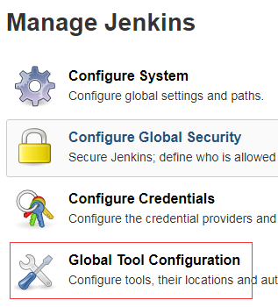
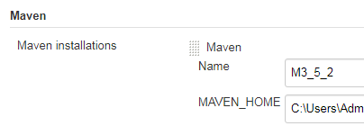
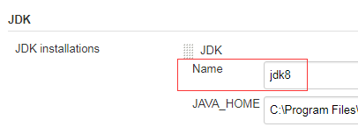
PIPELINE DIRECTIVE- DECLARATIVE
TOOLS
DECLARATIVE PIPELINE EXAMPLE - TOOLS DIRECTIVE
pipeline {
agent any
tools {
maven 'M3_5_2'
jdk 'jdk8'
}
stages {
stage('BUILD') {
steps {
echo “PATH: ${PATH}”
//sh 'mvn --version'
bat 'mvn --version'
bat 'java -version'
}
}
}
}
A section defining tools to auto-install and put on the PATH
This is ignored if agent none is specified
Required NO
Parameters NONE
Allowed Inside the pipeline block or a stage block
RESTRICTED

Slide 23
PIPELINE DIRECTIVE- DECLARATIVE
INPUT
DECLARATIVE PIPELINE EXAMPLE - INPUT DIRECTIVE
pipeline {
agent any
stages {
stage('BUILD') {
input {
message "Should we continue?"
ok "Yes, we should."
submitter "alice,bob"
parameters { // same as parameters directives
string(name: 'PERSON', defaultValue: 'Mr Jenkins', description: 'Who should I say hello to?')
}
}
steps {
echo “Hello, ${PERSON}”
}
}
}
}
allows you to prompt for input, using the input step
input will block the stage process. If approved, the stage will move forward
any parameters provided as part of the input submission will be available in the environment for the rest of the stage
Configuration Options
message
id
ok
submitter
submiiterParameter
parameters
string
booleaParam
Required NO
Parameters NONE
Allowed Inside the pipeline block or a stage block
RESTRICTED

Slide 24
PIPELINE DIRECTIVE- DECLARATIVE
WHEN
DECLARATIVE PIPELINE EXAMPLE - WHEN DIRECTIVE
pipeline {
agent none
stages {
stage('BUILD') {
agent {
label "some-label"
}
when {
allOf {
// execute when the Groovy expression evaluates to true
expression { BRANCH_NAME ==~ /(production|staging)/ }
branch 'production'
// execute when the env var was set to the given value
environment name: 'DEPLOY_TO', value: 'production'
}
}
steps {
echo “Hello, ${PERSON}”
}
}
}
}
to determine whether the stage should be executed depending on the given condition;
at least 1 condition. If more than 1, all child conditions must return true to execute;
by default, the when condition will be evaluated after stage agent; can be override by setting 'beforeAgent = true';
If beforeAgent is set to true, stage agent will process when condition evaluates to be true;
built-in conditions:
branch
environment
expression
not
allOf
anyOf
Required NO
Parameters NONE
Allowed Inside a stage directive
RESTRICTED

Slide 25
PIPELINE DIRECTIVE- DECLARATIVE
PARALLEL
DECLARATIVE PIPELINE EXAMPLE - PARALLEL DIRECTIVE
pipeline {
agent any
stages {
stage('Parallel Stage') {
failFast true
parallel {
stage('Branch A') {
agent { label "for-branch-a" }
steps { echo "On Branch A" }
}
stage('Branch B') {
agent { label "for-branch-b" }
steps { echo "On Branch B" }
}
}
}
}
}
stages in Declarative Pipeline may declare a number of nested stages within them, which will be executed in parallel;
any stage containing parallel cannot contain agent or tools;
can force your parallel stages to all be aborted when one of them fails, by adding failFast true to the stage containing the parallel
Required NO
Parameters NONE
Allowed Inside a stage directive
RESTRICTED

Slide 26
PIPELINE DIRECTIVE- DECLARATIVE
SCRIPT
DECLARATIVE PIPELINE EXAMPLE - SCRIPT DIRECTIVE
pipeline {
agent any
stages {
stage('Parallel Stage') {
steps {
echo 'Hello World'
script {
def browsers = ['chrome', 'firefox']
for (int i = 0; i < browsers.size(); ++i) {
echo "Testing the ${browsers[i]} browser"
}
}
}
}
}
}
script step takes a block of Scripted Pipeline and executes that in the Declarative Pipeline.
Required NO
Parameters NONE
Allowed Inside a stage directive
RESTRICTED

Slide 27
PIPELINE DIRECTIVE- SCRIPTED PIPELINE
Scripted Pipeline
is built on top of the underlying Pipeline sub-system
Scripted Pipeline is effectively a general purpose DSL built with Groovy
Most functionality provided by the Groovy language is made available to users of Scripted Pipeline
It can be a very expressive and flexible tool with which one can author continuous delivery pipelines
RESTRICTED

Slide 28
PIPELINE DIRECTIVE- SCRIPTED
FLOW CONTROL
SCRIPTED PIPELINE EXAMPLE
node {
stage('Example') {
if (env.BRANCH_NAME == 'master') {
echo 'I only execute on the master branch'
} else { echo 'I execute elsewhere' }
}
}
node {
stage('Example') {
try { sh 'exit 1' }
catch (exc) {
echo 'Something failed, I should sound the klaxons!'
throw
}
}
}
stages in Declarative Pipeline may declare a number of nested stages within them, which will be executed in parallel;
any stage containing parallel cannot contain agent or tools;
can force your parallel stages to all be aborted when one of them fails, by adding failFast true to the stage containing the parallel
Required NO
Parameters NONE
Allowed Inside a stage directive
RESTRICTED

Slide 29
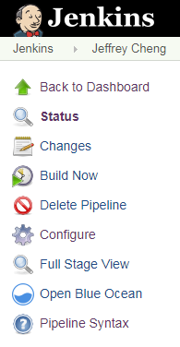
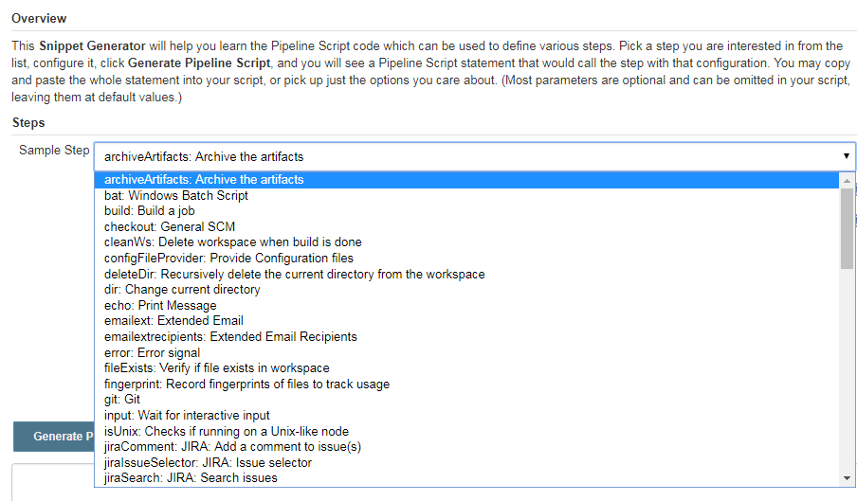

PIPELINE SYNTAX GENERATOR
PIPELINE SCRIPT EXAMPLE
node {
stage('Source Checkout') {
git branch: 'master',
credentialsId: '52dfa145-d4a0-4240-bae9-8f786e323bbe',
url: 'ssh://user@www.hostname.com:port/path/project.git'
}
}
RESTRICTED

Slide 30
TOOLS
&
PLUGINS

Slide 31
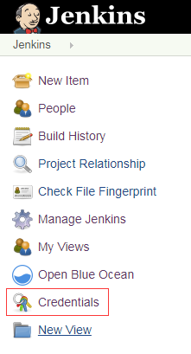
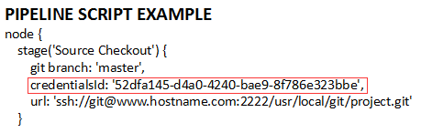
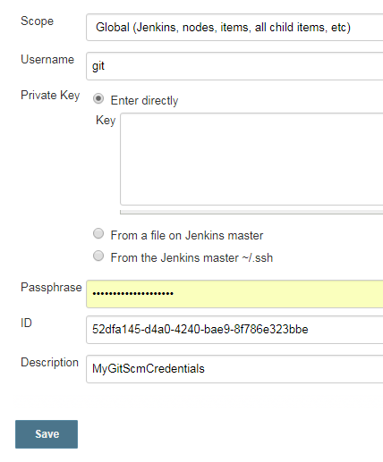
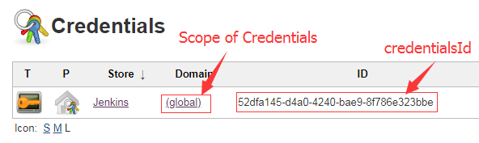
TOOLS & PLUGINS
CREDENTIALS
RESTRICTED

Slide 32
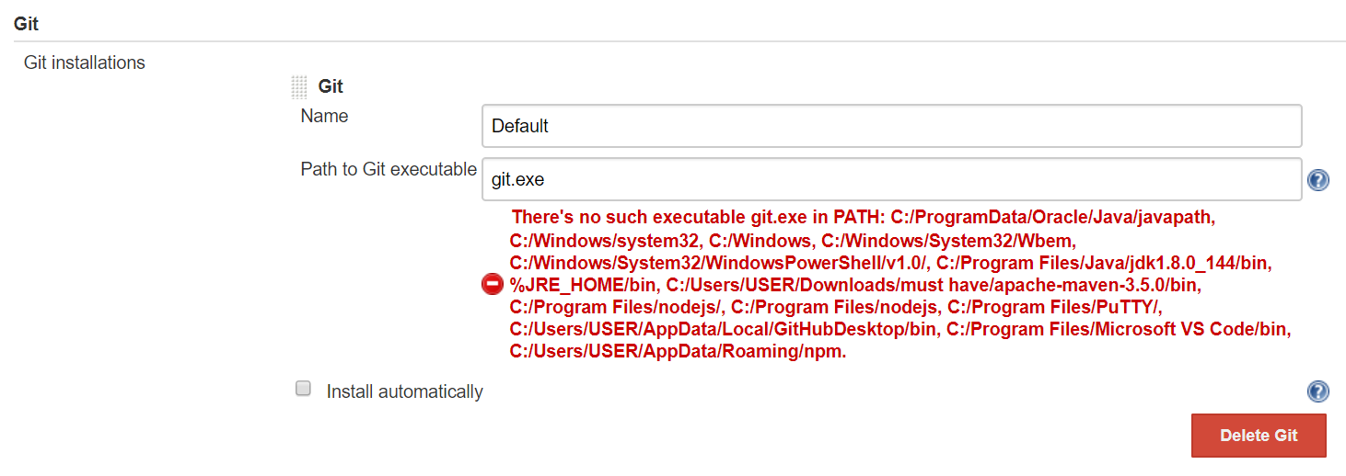
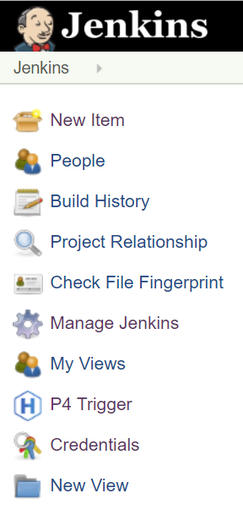
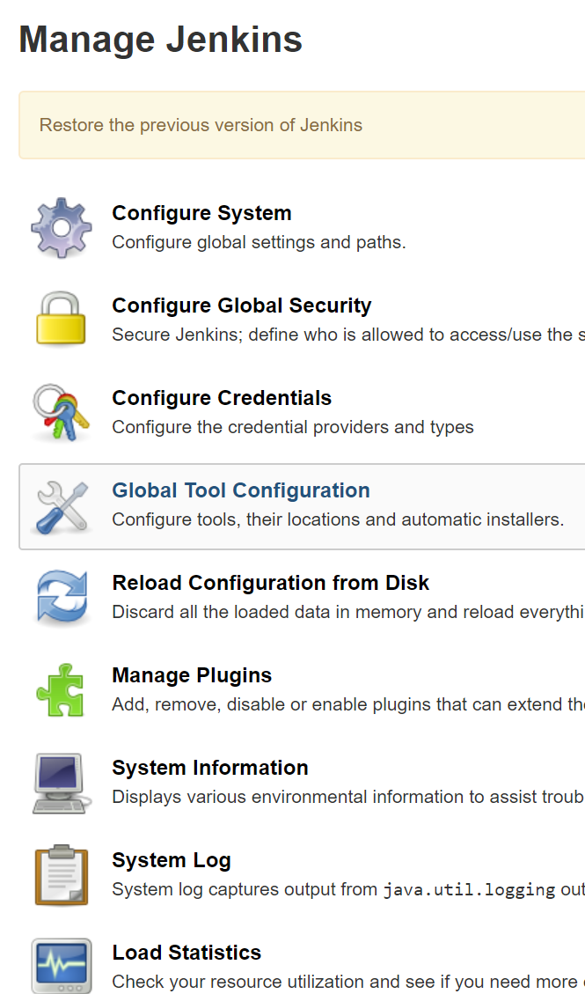
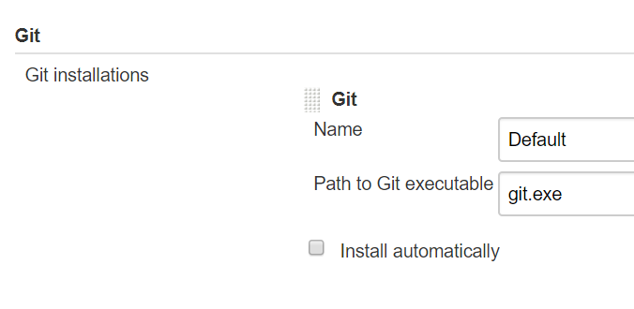
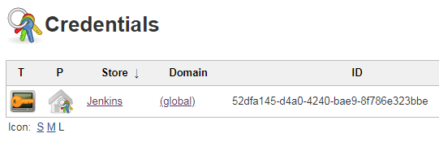
TOOLS & PLUGINS
GIT
PIPELINE SCRIPT EXAMPLE
node {
stage('Source Checkout') {
git branch: 'master',
credentialsId: '52dfa145-d4a0-4240-bae9-8f786e323bbe',
url: 'ssh://user@www.hostname.com:port/path/project.git'
}
｝
RESTRICTED

Slide 33
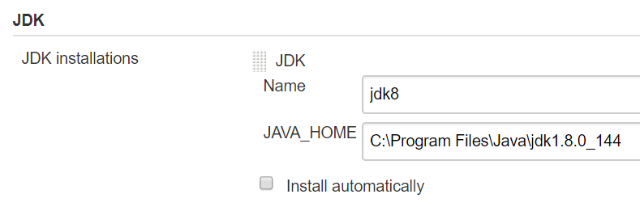
TOOLS & PLUGINS
JDK
RESTRICTED

Slide 34
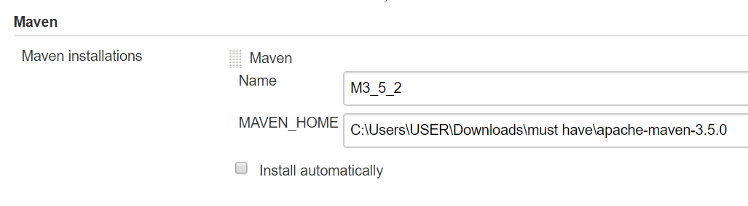
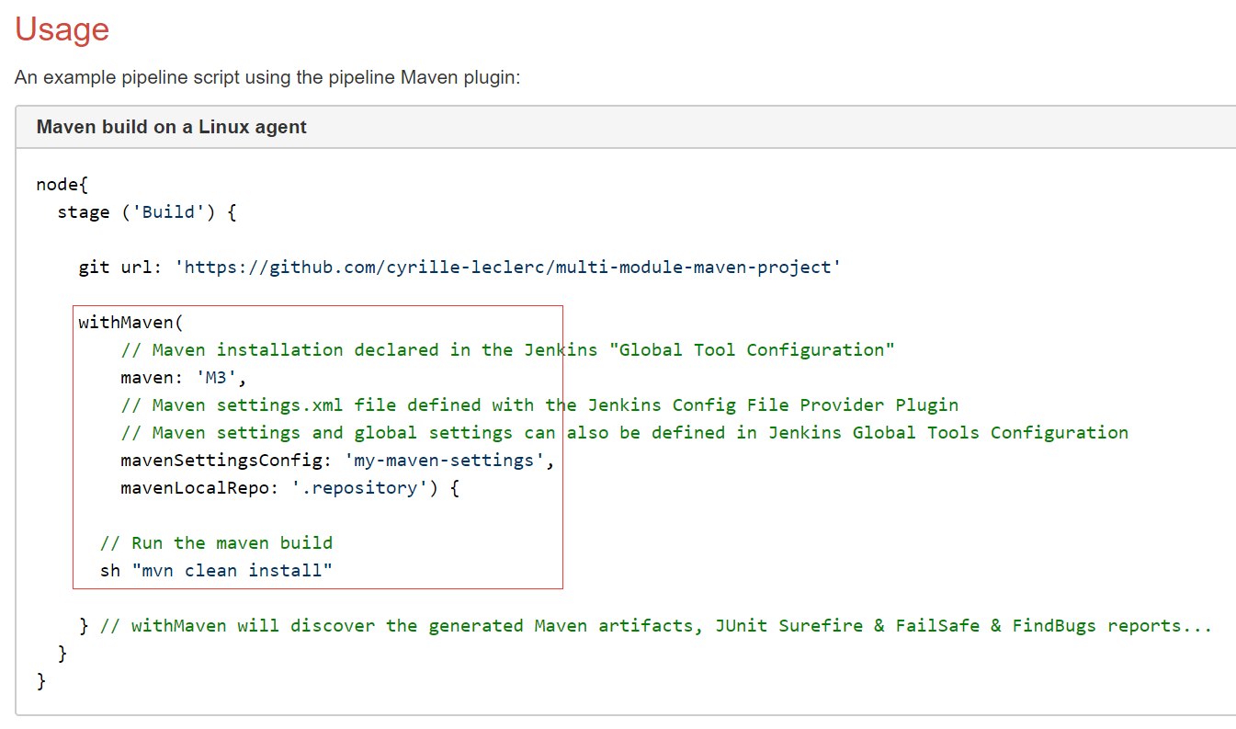
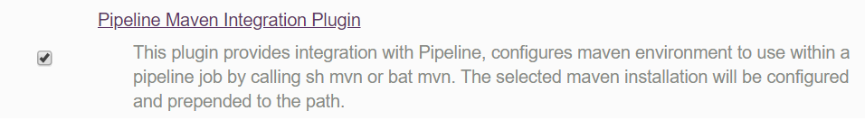
TOOLS & PLUGINS
MAVEN
PIPELINE SCRIPT EXAMPLE
node {
...
stage('Build') {
echo 'In Build Stage'
withMaven (maven: 'M3_5_2') {
// sh 'mvn clean package' for LINUX
bat 'mvn package'
}
}
...
}
RESTRICTED

Slide 35
SHARED LIBRARY

Slide 36
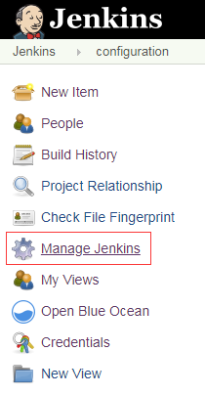
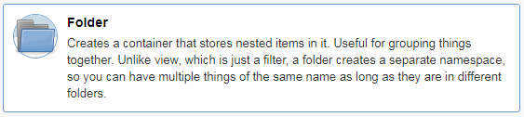
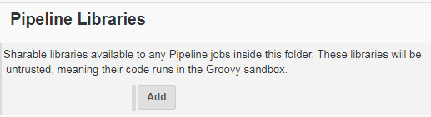
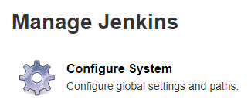
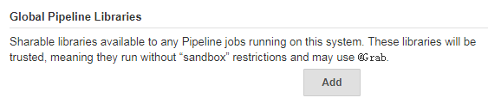
SHARED LIBRARIES
Folder-level Shared Library
Jenkins Shared Libraries is useful to share parts of Pipelines between various projects to reduce redundancies and keep code "DRY".
however, because tasks are running inside Jenkins, so things may behave a little different from in normal situation
Global Shared Library
RESTRICTED

Slide 37
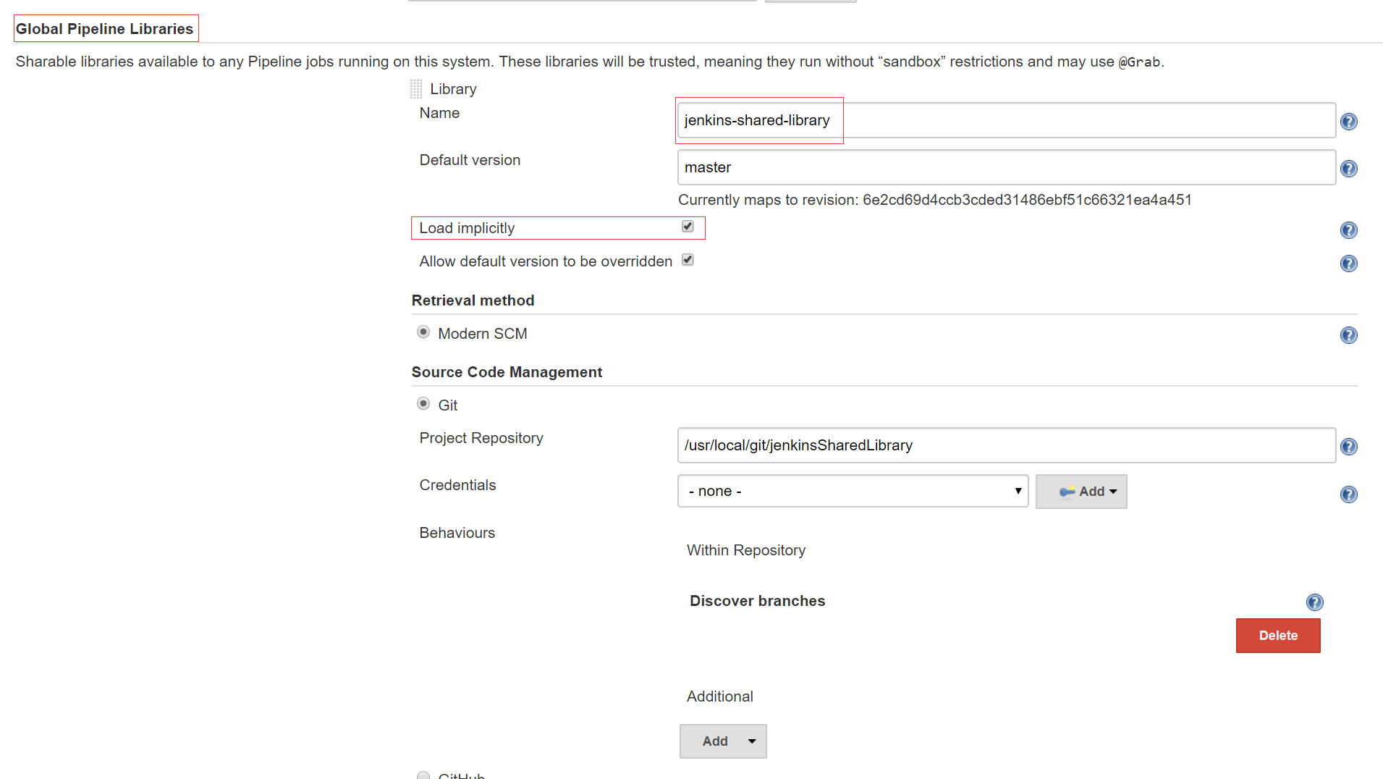
SHARED LIBRARIES
Configure Shared Library for Global-level or Folder-level
RESTRICTED

Slide 38
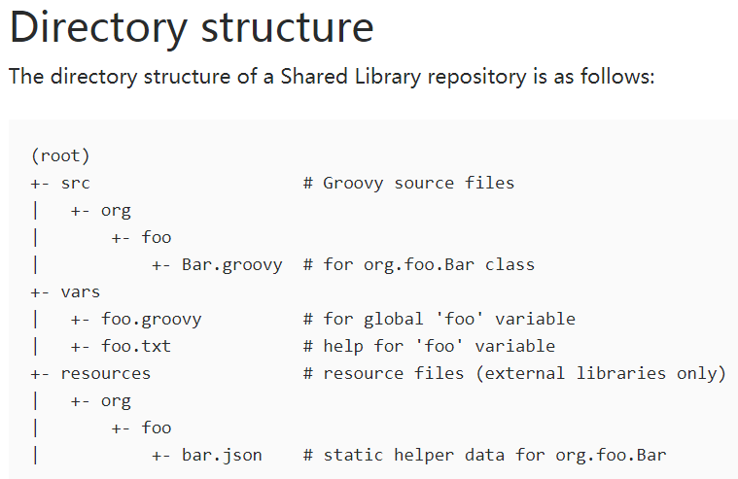
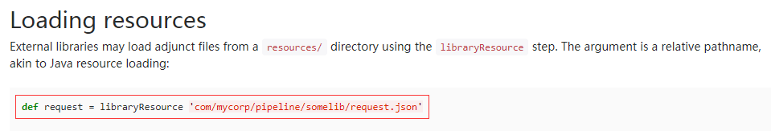
SHARED LIBRARIES
Groovy Project
DIRECTORY STRUCTURE
All classes should implement Serializable when they have state, this is needed in order to allow Jenkins to stop and resume our pipelines properly
The src directory has standard Java source directory structure. This directory is added to the classpath when executing Pipelines.
The vars directory hosts scripts that define global variables accessible from Pipeline
A resources directory allows the libraryResource step to be used from an external library to load associated non-Groovy files (say, JSON files).
RESTRICTED

Slide 39
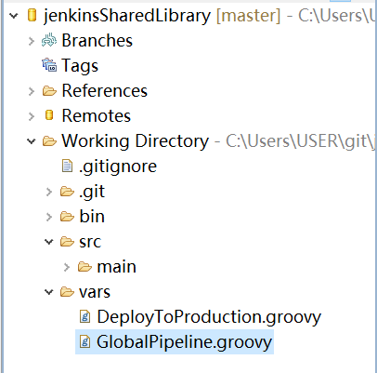
SHARED LIBRARIES
def call(String type, Map map) {
if (type == "maven") {
pipeline {
agent any
tools {
maven "${map.maven}"
jdk "${map.jdk}"
}
environment {
CREDENTIALS = credentials('deployToProductionCredentials_hivesplace')
}
options {
disableConcurrentBuilds()
timeout(time: 10, unit: 'MINUTES')
skipDefaultCheckout()
}
stages {
stage('Build Initialization') {
steps {
echo "Initilize Project Build Environment......"
}
}
stage('Build Project') {
steps {
script {
echo "building project......"
sh """
mvn clean package
"""
}
}
}
｝
stage('Unit Test') {
steps {
echo "stage unit test"
sh 'mvn test'
}
}
}
}
}
}
Grails Project -
GlobalPipeline.groovy
RESTRICTED

Slide 40
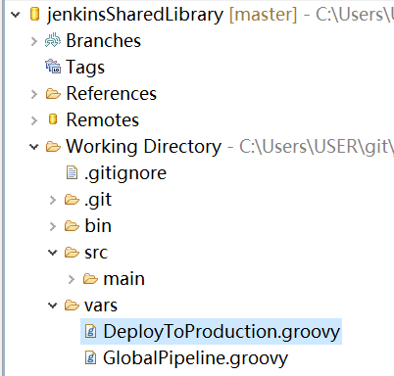
SHARED LIBRARIES
Grails Project - DeployToProduction.groovy
def call() {
timeout(time:5, unit: 'MINUTES') {
def userAccessToken = input(
id: 'userAccessToken', message: 'Please input password to proceed',
parameters: [
[$class: 'TextParameterDefinition', name: 'password']
]
)
return userAccessToken
}
}
RESTRICTED

Slide 41
SHARED LIBRARIES
maven project - jenkinsfile
import groovy.transform.Field;
library 'jenkins-shared-library'
@Field def map = [:]
map.put('maven','M3')
map.put('jdk','jdk8')
map.put('credentialsId','deployToProductionCredentials_hivesplace')
map.put('cicdPath','/usr/local/cicd/war')
map.put('mavenWar','home-0.1.0.BETA.war')
map.put('projectWar','home.war')
......
[con't to next]
......
[con't from previous]
def deployToProductionStage() {
stage name: 'Promote to Production Deploy Pipeline', concurrency: 1
def input = DeployToProduction()
map.put('userPassword',input)
node('master') {
withCredentials([usernamePassword(credentialsId: map.credentialsId,
usernameVariable: 'USERNAME', passwordVariable: 'PASSWORD')]) {
script {
if (map.userPassword == env.PASSWORD) {
sh """
pwd
rm -rf ${map.cicdPath}/${map.projectWar}
cp target/*.war ${map.cicdPath}
mv ${map.cicdPath}/${map.mavenWar} ${map.cicdPath}/${map.projectWar}
"""
} else {
echo 'Password not correct'
currentBuild.result = 'FAILED'
}
}
}
}
}
GlobalPipeline("maven",map)
//DeployToProduction()
deployToProductionStage()
RESTRICTED

Slide 42
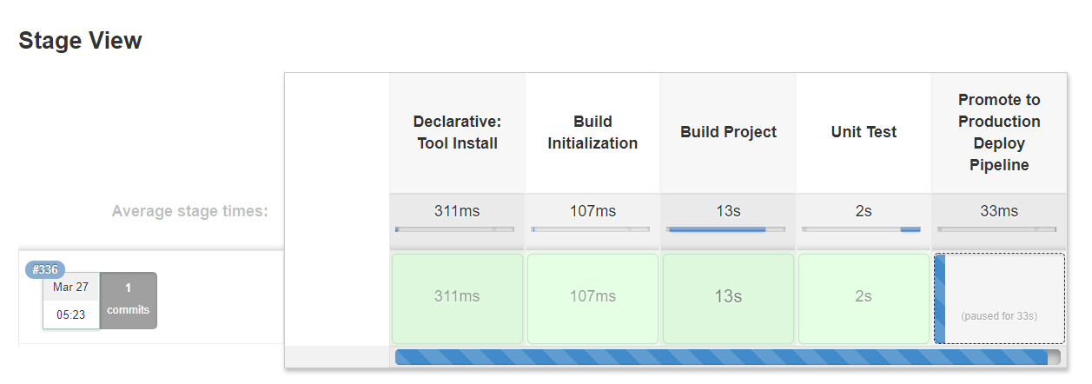
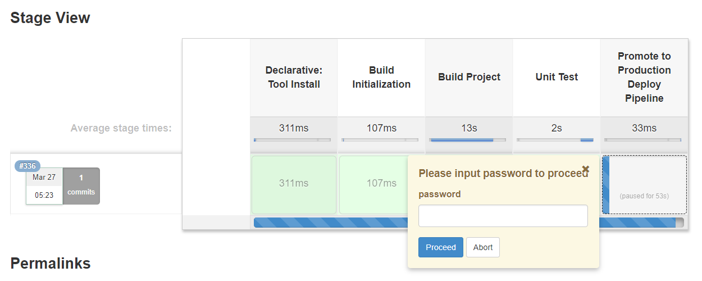
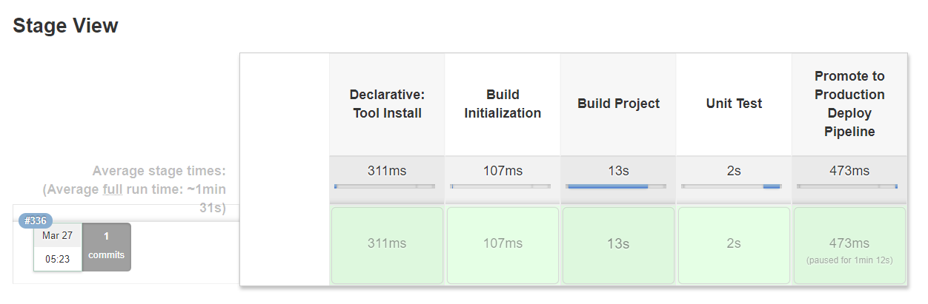
SHARED LIBRARIES
Pipeline Build - Global Shared Library Example
RESTRICTED

Slide 43
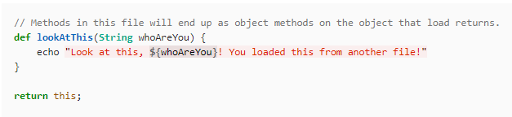
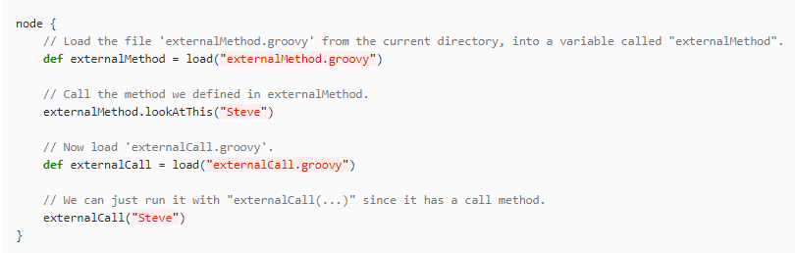
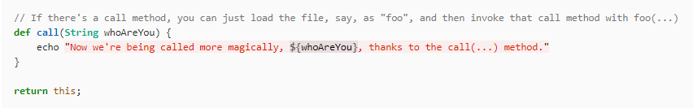
SHARED LIBRARIES
IMPORT FILES
vars/externalMethod.groovy
RESTRICTED

Slide 44
LESSONS
TO
SHARE

Slide 45
LESSONS TO SHARE
CALL FILE AS OBJECT
jenkinsfile
cannot has direct call for more than one file as object at one time
use def to import multi-files
GlobalPipeline("maven",map)
//DeployToProduction()
deployToProductionStage()
//GlobalPipeline("maven",map)
DeployToProduction()
deployToProductionStage()
GlobalPipeline("maven",map)
DeployToProduction()
//deployToProductionStage()
RESTRICTED

Slide 46
LESSONS TO SHARE
DYNAMIC VARS IN SHARED LIBRARY
don't try to put input block to accept dynamic input directly in a shared library. Put the input into an independent def function, otherwise, exception will occur.
DeployToProduction.groovy
def call() {
timeout(time:5, unit: 'MINUTES') {
def userAccessToken = input(
id: 'userAccessToken', message: 'Please input password to proceed',
parameters: [
[$class: '[$class:
'com.michelin.cio.hudson.plugins.passwordparam.PasswordParameterDefinition', name: 'password']
]
)
return userAccessToken
}
}
RESTRICTED

Slide 47
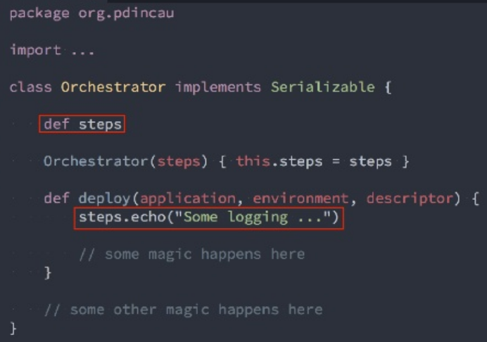
LESSONS TO SHARE
LOGGING IN CLASS
we cannot log directory using 'println' or 'echo';
we have to pass through 'steps.echo' to give logs
RESTRICTED

Slide 48
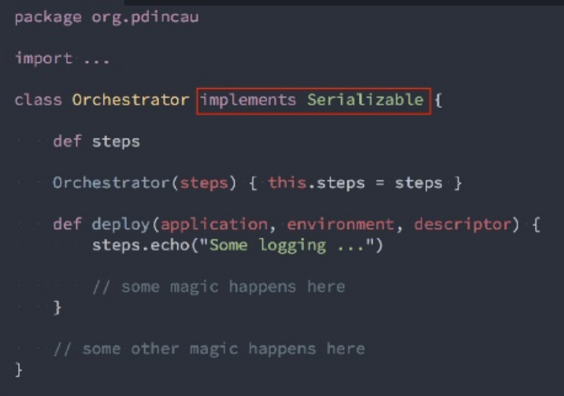
LESSONS TO SHARE
CLASS SERIALIZABLE
All classes should implement Serializable when they have state, this is needed in order to allow Jenkins to stop and resume our pipelines properly
RESTRICTED

Slide 49
DISCUSSION
THANKS FOR LISTENING
Prepared and Presented by: Jeffrey M W Cheng (43339225)

